Slide 1
EXERCISE PHYSIOLOGY
Dr. Santosh Dobhal
Dept. Of Cardiovascular & Respiratory Physiotherapy
MGM Institute Of Physiotherapy
Chh. Sambhajinagar

Slide 2
CONTENT
Nutrition (Bioenergetics)
Total energy expenditure (MET) sources
Acute and chronic adaptation to exercise
Complication of bed rest/ immobilization & prevention.
Aerobic and Anaerobic training
Principles of exercise prescription

Slide 3
Nutrition (bioenergetics)-
Refers to the flow of energy in a biological system; the conversion of micronutrients into biologically useable forms of energy.
Carbohydrate, fat, protein MAIN SOURCE

Slide 4
Nutrition (Bioenergetics)
Muscle depend upon carbohydrate
Fat provides energy during prolonged, less intense exercise
Protein can used but it must be first converted to glucose source

Slide 5
Nutrition (Bioenergetics)
ATP is formed by energy in food molecules bonds released and stored in cell
Energy from food is stored in form of ATP in cells
CHO- 4.1kcal/g
Fat – 9.4kcal/g

Slide 6
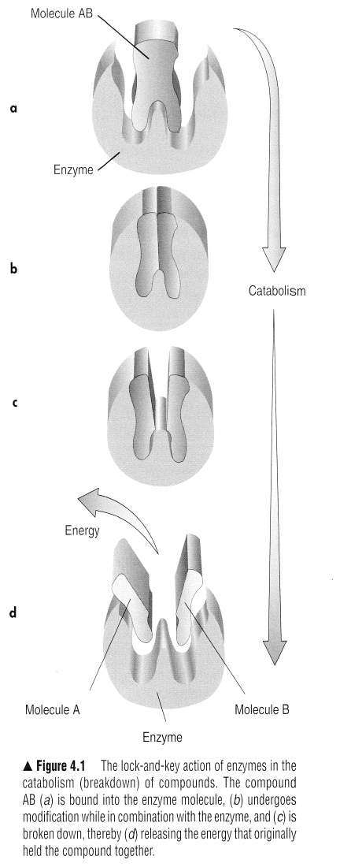
Basic energy systems
An ATP molecule =adenine combined with ribose and 3 Phoshpate
Adenine nitrogen based and
ribose 5 based sugar
ATP combined with water hydrolysis
Acted by ATPase last phosphate groups
splits and relseses 7.3 kcal/mole

Slide 7
Source of energy ?

Slide 8
Total energy expenditure (MET) sources
3 Energy systems
Phosphogen or The ATP PCr system
Anaerobic Glycolytic system
Aerobic system or oxidative system

Slide 9
Phosphagen or The ATP PCr system
Phosphocretanine and ATP are stored in the muscle cell
Phosphocretanine is the chemical fuel source
Anerobic
Muscle rested supply of ATP-PC is replenished
Maximum capacity of system is 0.7mol ATP/min
Power 3.7 mol ATP/min
Energy for short and quick burst of activity

Slide 10
Phosphagen or The ATP PCr system
Is the major source of energy during first 30 seconds of intense exercise

Slide 11
Anaerobic Glycolytic System
Glycogen (glucose) is the fuel source (glycolysis).
Anaerobic.
ATP is resynthesized in the muscle cell.
Lactic acid is produced (by-product of anaerobic
glycolysis).
Maximum capacity is intermediate (1.2 mol ATP).
Maximum power is intermediate (1.6 mol ATP/min).
Energy for activity of moderate intensity and short duration.
It is the major source of energy from the 30th to 90th second of exercise.

Slide 12
Aerobic System
Glycogen, fats, and proteins are fuel sources and are utilized relative to their availability and the intensity of the exercise.
Oxygen is required (aerobic).
ATP is resynthesized in the mitochondria of the muscle cell.
The ability to metabolize oxygen and other substrates is related to the number and concentration of the mitochondria and cells.
The maximum capacity of the system is great (90.0 mol ATP).
The maximum power of the system is small (1.0 mol ATP/min).
The system predominates over the other energy systems
after the second minute of exercise.

Slide 13
Total energy expenditure (MET) sources
Energy is expanded by individuals engaging in physical activity and is expressed in kilocalories
Energy cost - Light , moderate, heavy
Energy cost is affected by mechanical efficiency and body mass

Slide 14
Total energy expenditure (MET) sources
Quantification
Amount of oxygen consumed
Units= kilocalories or METs
Kilocalorie =amount of heat necessary to raise 1 kg of water 1º Celcius
5kcal= 1 liter of O2

Slide 15
Total energy expenditure (MET) sources
A MET is defined as the oxygen consumed in ml/kg of body weight /min (mL/kg )
1 MET= 3.5mL/kg/min
the average individual engaged in normal daily tasks expends 1800 to 3000 kcal /day
Athlete > 10000 kcal/day

Slide 16
Total energy expenditure (MET) sources
Workoutput= force x distance
unit= power or work /time
Efficiency = useful work output/energy expanded or work input x 100

Slide 17
Acute and chronic adaption to exercise
Acute physiological response to exercise
Chronic Physiological adaption to exercise

Slide 18
↑ in energy requirement during exercise require change in circulatory adjustments to meet ↑ need of Oxygen and nutrients to remove the end product of metabolism such as CO2 , lactic acid and to dissipate heat.
By coordinated activity of all the systems neuromuscular, respiratory, cardiovascular, metabolic, hormonal.

Slide 19
Acute Physiological response to exercise
How body responds to single bout of exercise E.g. Running on treadmill
Heart activity ( Heart rate and electrocardiogram)
Respiration rate
Ventilation
Oxygen consumption
Skin and deep body temperature
Muscle activity(Electromyogram)

Slide 20
Acute physiological response to exercise
Cardiovascular response
Exercise Pressor Respone - Stimulation of small myelinated and unmylineated fibers in skeletal muscles involve SNS.
SNS -Generalized peripheral vasoconstriction in non exercising muscles, Increased myocardial contractility, Heart rate, increased SBP. ↑ redistribution of the cardiac output.
Muscle mass and intensity of exercise.

Slide 21
Acute Physiological response to exercise
Cardiac effects-
Frequency of SA node depolarization increases as does the heart rate.
↓ in vagal stimuli as well as an increase in SNS stimulation
Increase in force development of the cardiac fibers

Slide 22
Acute physiological response to exercise
Peripheral effects-
Net reduction in total peripheral resistance
Peripheral effects- net reduction in total peripheral resistance generalized vasoconstriction or shunt to working muscles from non working muscles.
Locally mediated reduction in resistance in the working muscle arterial vascular bed independent of ANS is produced by metabolites such as Mg2⁺ ,Ca2⁺ , ADP, Pco2
The veins of working and nonworking muscles remain constricted

Slide 23
Acute physiological response to exercise
Peripheral effects
↑ Increased cardiac output
Myocardial contractility with increase in stroke volume
In heart rate
Blood flow through working muscles
Constriction of the capacitance vessels on the venous side raising Peripheral venous pressure
Increased systolic pressure

Slide 24
Acute Physiological response to Exercise
Respiratory response to exercise
Before exercise- gas exchange O₂,CO₂ ↑ across alveo-capillary membrane by 1st or 2nd breath.
Increased muscle metabolism more O₂ extracted from arterial blood resulting in increase in venous PCO₂ and H⁺ ↑ Body temp. increased epinephrine and propriocetion.
Increase in minute ventilation as Respiratory frequency and Tidal volume increase

Slide 25
Increased blood flow
Increased blood flow to the muscle
Increased oxygen extraction

Slide 26
Factors to consider During Monitoring
Temperature
Humidity
Time
Size of the subject’s last meal and the quantity and Quality of sleep The night before

Slide 27
Chronic Physiological Adaptations To Exercise
How Body respond over time to the stress of repeated exercise
Regular exercise adaptation
Resistance training muscle become stronger and Aerobic training heart and lungs become more efficient and endurance capacity increases.
Adaptations is specific to the type of training

Slide 28
Chronic Physiological Adaptations To Exercise
Principle of individuality- Heredity, variations in cellular growth rate, metabolism and neural and endocrine regulation also lead to tremendous individual variation.
Individuals have different capacity so they are unlikely to show precisely the same adaptations to a given training program.
Responders and nonresponders

Slide 29
Training programme must take into account the specific needs and abilities of the individuals for whom it is designed this is called Principal of individuality

Slide 30
Chronic Physiological Adaptations To Exercise
Principal of Specificity: The training programme must stress the physiological systems that are critical for optimal performance in the given sport in order to achieve specific training adaptations.
Training adaptations are highly specific to the type of activity and to the volume and intensity of exercise.

Slide 31
Chronic Physiological Adaptations To Exercise
Eg. Muscular power shot putter would not emphasize on distance running or slow , low intensity resistance training.
Similarly the distance runner wouldn’t concentrate on sprint-type interval training.
Athlete who have great strength and power , such as weightlifters , often have great strength but don’t have better aerobic endurance.

Slide 32
Chronic Physiological Adaptations To Exercise
Principal of Disuse: “Use it or Lose it”
Regular physical exercise improves your muscles’ capacity to generate more energy and to resist fatigue.
Endurance training improves your ability to perform more work for longer periods. But if you stop training, your state of fitness will decrease to a level that meets only the demands of daily use.

Slide 33
Chronic Physiological Adaptations To Exercise
Principal of progressive overload:
Overload and Progression foundation of all training
All training programs must include these components.
Eg. To gain muscle strength, the muscles’ must be overloaded, beyond the point to which they are normally loaded.

Slide 34
Chronic Physiological Adaptations To Exercise
Progressive Resistance Training -as muscles become stronger, a proportionately greater resistance is required to stimulate further strength increase.
Eg. 10 reps bench press using 68kg with 1 week or 2 increase 14 or 15 reps with same weight he then can add 2.3 kg with less reps then as he continues he can increase reps.

Slide 35
Chronic Physiological Adaptations To Exercise
Principal of Hard/Easy:
Training hard includes training each day at high intensity or for long durations or both
Hard workout break the body down and that you need a day or two to recover to achieve your optimal training adaptations.
Hard day workout followed by easy day training provide active recovery so that the body is ready for next day of training.

Slide 36
Chronic Physiological Adaptations To Exercise
Principal of Periodization: Is the gradual cycling of specificity, intensity and volume of training to achieve peak levels of fitness for competition.
With periodization the volume and intensity of training are varied over a macro cycle which is generally a year of training.

Slide 37
Chronic Physiological Adaptations To Exercise
A macrocycle is composed of two or more mesocycles that are dictated by the dates of major competitions.
Each mesocycle is subdivided into periods of preparation, competition and transition.

Slide 38
Chronic Physiological Adaptations To Exercise
Neuromuscular adaptations to training
Metabolic adaptations to training
Cardiovascular adaptations
Respiratory adaptations

Slide 39
Neuromuscular Adaptations to Resistance Training
Strength-a maximal force a muscle or muscle group can generate is termed strength
Power- strength and speed of movement.
Endurance- the capacity to sustain repeated muscle actions such as performing push ups sit ups or to sustain static muscle actions for an extended period of time.

Slide 40
Neuromuscular Adaptations to Resistance Training
Resistance training can produce substantial strength gains within 3- 6 months.
Hypertrophy increase in muscle mass
Cause and effect relationship exists between muscle size and muscle strength
Neural control of the trained muscle is also altered allowing a greater force production from the muscle.

Slide 41
Neuromuscular Adaptations to Resistance Training
Increase in motor unit recruitment.
Synchronization and recruitment of additional motor units-
The motor unit is activated and its muscle fibers contract only when the incoming excitatory impulses exceed the inhibitory impulses and threshold met.

Slide 42
Neuromuscular Adaptations to Resistance Training
Strength gain result from changes in the connections between motor neurons located in the spinal cord, allowing motor units to act more synchronously facilitation contraction and increasing the muscle’s ability to generate force.
Autogenic inhibition- Inhibitory mechanism in neuromuscular system such as GTO Prevent muscles from exerting more force than the bones and connective tissue tolerate.

Slide 43
Neuromuscular Adaptations to Resistance Training
Training can gradually reduce or counteract these inhibitory impulses, allowing the muscle to reach greater levels of strengths.
Muscle hypertrophy-
Transient Hypertrophy- pumping of muscle during single bout of exercise from fluid accumulation in the interstitial and intercellular space.
Chronic hypertrophy-
fiber hyperplasia- eccentric muscle training increase fast twitch fiber,
Concentric Training limit muscle hypertrophy and increases muscle strength

Slide 44
Metabolic Adaptations
Changes with aerobic and anaerobic training
Change in aerobic power - ↑ ability to perform prolonged submaximal exercise and increase I One’s maximal aerobic capacity VO2max
Muscle fiber type-Slow Twitch(ST) become larger, Fast Twitch(FT) FTa are used more than FTb. long duration exs eventually recruit them and take chara of FTa

Slide 45
Metabolic Adaptations
Capillary supply- increase in number of capillaries surrounding each muscle fiber
Myoglobin content- O2 enters the muscle fiber, it binds to myoglobin Hb. ST fibers contain more myoglobin so they appear red.
FT require are highly glycolytic so they require little myoglobin appear white.

Slide 46
Metabolic Adaptations
Mitochondrial function- the ability to use oxygen and produce ATP via oxidation depedns on size, number and efficiency of muslce’s mitochondria.
Increase in skeletal muscle mitochondria in size and number with aerobic training.
Oxidative Enzymes- Increase in Succinate dehydrogenase, ATPase

Slide 47
Metabolic Adaptations
Adaptations to anaerobic training :
Change in anaerobic power and anaerobic capacity
Sprint training and resistance type training recruit FT muscle fibers significantly more than aerobic activites FTa and FTb muscle fibers undergo an increase in their cross sectional area.

Slide 48
Metabolic Adaptations
Adaptations to anaerobic training
It alters ATP-PCr and anerobic glycolytic energy systems.
The higher the lactate threshold the better aerobic performance.

Slide 49
Cardiovascular Adaptations To Training
Heart size
Stroke volume
Heart rate
Cardiac output
Blood flow
Blood pressure
Blood volume

Slide 50
Cardiovascular Adaptations To Training
Heart mass and volume increases with training
“Cardiac hypertrophy” induced by exercises called “athlete’s heart “
Left ventricle
Type of exercise
Eg. Resistance training LV must contract against high blood pressure in the systemic circulation High afterload. To ovecome this increase size and increasing contractility.

Slide 51
Cardiovascular Adaptations To Training
Endurance type training LV Filling increases this is largely attributed to a training induced increase in plasma volume that increases left ventricular end diastolic volume.↑ in preload.
↓ in HR at rest and during exercise at the same rate allows a longer diastolic filling period.
The increase in plasma volume and diastolic filling period increase LV chamber size at the end of diastole.

Slide 52
Cardiovascular Adaptations To Training
Stroke volume: it is overall increase.
After endurance training program SV at reat is higher.
Increase in diastolic volume leads to increase in blood plasma and greater diastolic filling period.

Slide 53
Cardiovascular Adaptations To Training
Resting heart rate: decrease heart rate after endurance training because of increase in parasympathetic activity in the heart.
Submaximal heart rate – Greater aerobic conditioning results in proportionally lower heart rate.
After a 6 month endurance training program of moderate intensity , decrease in heart rate of 10 to 30 beats/ min Aare common at the same standardized submaximal rate of work.

Slide 54
Cardiovascular Adaptations To Training
Cardiac output:
SV ↑ But heart rate at rest and for the same rate of work generally ↓
Cardiac output at rest or during submaximal levels of exercise remains unchanged or ↓ slightly.
Cardiac output at maximal levels of exercise increases considerably coz of in ↑ SV

Slide 55
Cardiovascular Adaptations To Training
Blood flow: results from
1. increased capillarization
2. Greater opening of existing capillaries
3. More effective blood redistribution
4. Increased blood Volume.

Slide 56
Cardiovascular Adaptations To Training
Blood Pressure:
Resting BP is reduced by endurance training in moderate hypertension
Endurance training results in reduction of BP at the same sub maximal work rate.
At maximal rates of work, SBP is increased and DBP is decreased.

Slide 57
Respiratory adaptations to training
The combined effect of Increased TV and Respiration Rate is an increase in Pulmonary ventilation during maximal effort following training
Pulmonary diffusion at maximal work rates increases, probably because of increased ventilation and increased lung perfusion.

Slide 58
Respiratory adaptations to training
The a-vO2 difference increase with training , most notably at maximal levels of work, reflecting increased oxygen extraction by the tissues and more effective blood distribution to the active tissues.

Slide 59
Complications Of Bed Rest

Slide 60
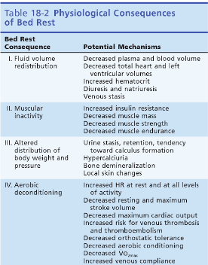

Slide 61
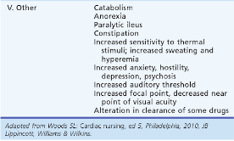

Slide 62
Complication of bed rest
Effects on the muscles and bones
The musculo-skeletal system functions best when supporting the body in an upright posture against gravity. The weight-bearing muscles of the neck, abdomen, lower back, buttocks, thighs and calves are particularly important for this purpose, and the deterioration caused by bed rest affects these muscles most seriously.
When muscles aren’t used, they rapidly begin to weaken and atrophy (waste away). Strength can decrease as much as 20-30% after only a week of complete bed rest, and it generally takes much longer to regain the strength than it took to lose it.

Slide 63
Decreased muscle strength, together with other structural changes to the nerves and muscles, affects co-ordination and balance, and increases the risk of falls.
Bed rest also causes the bones to lose density because they aren’t performing their normal weight-bearing function. The leg bones are the most likely to be affected. Thinner bones increase the risk of fractures, even with minor falls.
Immobility can also lead to limited joint movement. The cartilage around joints begins to deteriorate, while the connective tissue thickens and the muscles shorten, typically at the hip, knee and shoulder. This negatively affects walking and daily activities.

Slide 64
Effects on the heart and blood
Like the muscular system, the cardiovascular system functions best when the body is in an upright position, working against gravity. After just a few days of bed rest, blood starts to pool in the legs. On standing, this can lead to dizziness and falls.
Immobility also causes the heart to beat more quickly, and the volume of blood pumped is lower. The volume of blood generally in the body is lower, and there is less oxygen uptake by the body. This results in poorer aerobic fitness and fatigue sets in more easily.
The blood also becomes thicker and stickier, which increases the risk of a blood clot forming, especially in the legs (deep vein thrombosis) and the lungs (pulmonary embolism).

Slide 65
Effects on the lungs and blood
Bed rest increases the risk of pneumonia and atelectasis (collapse of lung tissue).
Fluid tends to build up in the lungs because the muscles aren’t working to remove excess fluid from the body. It’s harder for the lungs to expand when you’re lying flat, so blood pools in the chest area, leading to decreased lung volume. Coughing is not as effective due to weakened abdominal and chest muscles, causing mucus to collect in the lungs.
Breathing also becomes shallower, which leads to poorer oxygen-carbon dioxide exchange in the lungs.

Slide 66
Effects on the skin
Bed sores or pressure sores are a kind of skin ulcer and are a common result of the additional pressure placed on parts of the body resting on the bed surface: the blood supply to the skin covering these parts becomes insufficient.

Slide 67
Effects on digestion and excretion
Constipation is common, due to several factors including decreased mobility, decreased fluid intake, decreased peristalsis (movement of the digestive tract) and incomplete emptying of the bowels.
Appetite is often suppressed in bedridden patients, and malnutrition and dehydration may occur if proper attention is not paid to diet.
Prolonged bed rest also makes urination less effective. The bladder is harder to empty and tends to retain fluid, which can lead to infection. There is also greater excretion of urinary calcium, which raises the risk for bladder and kidney stones.
Incontinence due to bed rest is also common: disorientation, confusion and decreased mobility can all contribute to this problem.

Slide 68
Effects on the metabolism and hormonal system
Prolonged bed rest can cause numerous complex changes in the balance of hormones and minerals in the body, and in how the body processes energy.
For example, immobility causes a reduction in the percentage of lean mass to body fat, and raises the risk of developing diabetes: immobile muscles can develop reduced insulin sensitivity, which in turn leads to raised blood sugar levels.

Slide 69
Effects on the brain
Bed rest in combination with the stress of illness are associated with increased risk for various mental health and cognitive issues, including anxiety, depression, irritability, apathy, sleep disturbances and confusion.
Many of these ill effects can be greatly reduced by short spells of mild activity – every little bit helps, even if only getting up to walk a few steps every day. Some exercises can even be done while lying down, if you aren’t yet able to stand easily. Be sure to plan and follow an exercise and recovery programme in consultation with your health professionals.

Slide 70
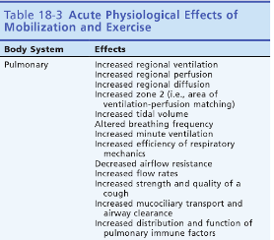

Slide 71
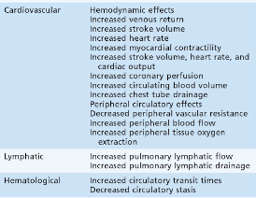
Acute Physiological Effect Of Mobilization And Exercise

Slide 72
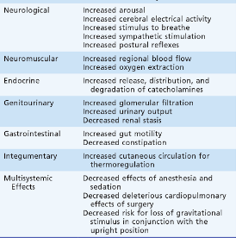
Acute Physiological Effect Of Mobalization And Exercise

Slide 73
Aerobic and Anaerobic training

Slide 74
GENERAL PRINCIPLES OF EXERCISE PRESCRIPTION

Slide 75
An Introduction to Principles of Exercise Prescription
FITT-VP principle of exercise prescription
  Frequency (how often)
  Intensity (how hard)
  Time (duration or how long)
  Type (mode or what kind)
  Total Volume (amount)
  Progression (advancement)

Slide 76
COMPONENTS OF EXERCISE PRESCRIPTION
Mode
Intensity
Duration
Frequency
Progression of physical activity

Slide 77
Components of the Exercise
Training Session
Warm-up: at least 5–10 min of light-to-moderate intensity cardiorespiratory and muscular endurance activities
Conditioning: at least 20–60 min of aerobic, resistance, neuromotor, and/or sports activities (exercise bouts of 10 min are acceptable if the individual accumulates at least 20–60 min · d⁻¹ of daily aerobic exercise)
Cool-down: at least 5–10 min of light-to-moderate intensity cardiorespiratory and muscular endurance activities
Stretching: at least 10 min of stretching exercises performed after the warm-up or cool-down phase

Slide 78
General Considerations for
Exercise Prescription
The optimal Ex R_{x} should address the health-related physical fitness components of
Cardiorespiratory fitness
Body composition
Muscular fitness
Flexibility
Neuromotor control

Slide 79
Purpose Exercise prescription
Ensure physical fitness
Promote health by reducing risk factors for chronic diseases
Safety during exercise participation

Slide 80
COMPONENTS OF HEALTH RELATED PHYSICAL FITNESS
Body composition
CR fitness
Muscular strength
Muscular endurance
Flexibility

Slide 81
PRINCIPLES OF TRAINING
Overload
Specificity

Slide 82
OVERVIEW OF THE EXERCISE PRESCRIPTION
Based on
Individual interests
Health needs
Clinical status

Slide 83
OBJECTIVE EVALUATION
HR
BP
RPE
ECG (when applicable)
VO_{2MAX}

Slide 84
Exercise prescription should be developed with careful consideration of individuals health status, risk factor profile, behavioral characteristics, personal goals and exercise preferences

Slide 85
THE ART OF EXERCISE PRESCRIPTION
Successful integration of exercise science with behavioral techniques that result in long term program compliance and attainment of the individuals goals

Slide 86
COMPONENTS OF TRAINING SESSION
Warm up-10-30%VO2R
Stimulus or conditioning phase
Recreational activities
Cool down

Slide 87
CARDIO RESPIRATORY EXERCISE PRESCRIPTION
Mode of exercise
Exercise intensity
Exercise duration
Exercise frequency

Slide 88
MODE OF EXERCISE
Use of constant mode of exercise for both testing and training provides ideal specificity- most accurate measure of change in oxygen consumption.

Slide 89
Grouping of cardiorespiratory endurance activities
Group 1 – activities that can be maintained at a constant vel.,energy expenditure is relatively low; early stages of rehab
Group 2 – activities in which rate of energy expenditure is highly related to skill, can provide constant intensity for a given individual; early stages of conditioning.

Slide 90
Group 3 –activities where both skill and intensity of exercise are highly variable; must be employed cautiously for high risk ,low fit and symptomatic individuals;

Slide 91
EXERCISE INTENSITY
40%/50% to 85% VO2R or HRR
or
64%/70% to 94% VO2max or HRmax

Slide 92
FACTORS TO BE CONSIDERED BEFORE DETERMINING THE LEVEL OF EXERCISE INTENSITY
Fitness level of the individual
Medical condition
Medications
Individual objectives and preferences
Risk of injuries is higher and adherence lower with high intensity exercise.

Slide 93
VO2
Heart rate methods
Direct
Percent of HRmax(0- peak method)
HR reserve method (Karvonen)
Rating of perceived exertion

Slide 94
INTENSITY PRESCRIPTION BY VO₂
Target VO₂= VO₂R* ex intensity + VO₂rest
➔Target VO₂= (VO₂max – VO₂rest)*ex intensity + VO₂rest
VO₂rest= 3.5ml/kg/min
Ex intensity= 40%/50%- 85%

Slide 95
HEART RATE RESERVE METHOD
Target HR= HRR* ex intensity+HRrest
Target HR= (HRmax-HRrest)*ex intensity+HRrest

Slide 96
RATING OF PERCEIVED EXERTION
Used as an adjunct to monitoring heart rate
Avg RPE associated with physiologic adaptation to exercise- 12 - 16

Slide 97
EXERCISE DURATION
20 – 60 min of continuous or intermittent
60 -80% of HRR or 77% -90% of HRmax for 20-30 min - fulfils most of the goals.
Duration can be increased as an individual adapts

Slide 98
EXERCISE FREQUENCY
3-5 days/week
60- 80% of HRR or 77-90% HRmax- 3d/wk
Based on the functional capacities
<3 MET- multiple brief daily sessions
3-5 MET- one or two short sessions per day
>5 MET – 3-5 sessions/wk
Vigorous training 7 d/wk is not recommended.

Slide 99
EXERCISE EXPENDITURE GOALS
150-400 kcal /day
Excess of 2000 kcal /week →short term and long term weight control
Accelerometer –estimate caloric expenditure
(METs * 3.5 * body weight in kg)/200= kcal/ min

Slide 100
RATE OF PROGRESSION
Initial conditioning stage
Improvement stage
Maintenance stage

Slide 101
INITIAL CONDITIONING STAGE
GOALS-
Prepare for novel activities
Develop orthopedic tolerance
Extended warm up
Moderate intensity-40%-60%HRR
Interval (15-30 min)
Extended cool down
3-4times/week →4 weeks

Slide 102
IMPROVEMENT STAGE
GOAL- gradual increase in the overall ex stimulus
Progressed at a very rapid rate
Intensity – 60%-85% HRR
Duration –increased constantly- 20%/wk
Frequency and magnitude of increment- rate of adaptation.
Intensity increment-5% of HRR every 6th session

Slide 103
MAINTANANCE STAGE
GOAL- Long term maintenance of CR fitness
Begins after the individual has reached pre established goals
No inc in conditioning stimulus.

Slide 104
RESISTANCE EXERCISE PRESCRIPTION
Cardiovascular stress of lifting and holding a given weight is proportional to the percentage of maximal strength involved.

Slide 105
Increases heart rate because of sympathetic simulation, but HR is disproportion to O₂ consumption.
Little inc in VO₂max.
Circuit weight training – average improvement in VO₂max of about 6%.
Energy expenditure estimates range from 4 – 10 kcal/min in actual resistance training.

Slide 106
Intensity of resistance exercise is not easily determined.
Percentage of 1 rep max – does nt potray true intensity.
RM indicates that the muscle has reached a point of fatigue in which the force generating capacity falls below the required force to shorten the muscle against the imposed resistance.
Momentary muscular fatigue in the concentric portion of an exercise performed in strict form represents high intensity.

Slide 107
Initial goal- 12-13 on RPE
Final goal- 15- 16 on RPE
Increase of intensity by
Inc of weight
Inc of rep
Reducing momentum
Maintaining muscular tension versus “locking out” joint when performing multiple joint ex.

Slide 108
Resistance training guidelines
Mode of exercise- comfortable
8-10 separate exercises- major groups of muscles
One set of each exercise to the point of volitional fatigue.
8-12 rep, rhythmic,moderate repetition duration

Slide 109
Ex each muscle group for 2- 3 non consecutive day
Allow enough time between exercise
For people with high cardiovascular risk or chronic disease terminate exercise as the concentric part of ex becomes difficult.(RPE 15-16)

Slide 110
Both concentric and eccentric phase should be performed in control manner.
Maintain a normal breathing pattern
Exercise with a training partner .

Slide 111
FLEXIBILITY EXERCISE PRESCRIPTION
Stretching -Defined as the systematic elongation of the musculotendinous units to create a persistent length of muscle and a dec in passive tension.
Muscles have viscoelastic properties- permits a gradual dec in tension or force within the muscle at a given length.

Slide 112
Static stretching
Dynamic
PNF

Slide 113
Flexibility Ex prescription
Preceding stretching with a warm up to elevate muscle temp
Static stretching of major muscle tendon units
2- 3 days /week ideally 5-7 days /week
Stretch to the EROM at a point of tightness
Hold for 15 -30 sec
2-4 rep for each stretch.

Slide 114
MAINTANAINCE OF TRAINING EFFECT
A significant reduction of 5%- 10% in vo2max has been reported within 3 weeks of stopping intense endurance training with most of the reduction attributed to dec blood vol.

Slide 115
Participants may return to pre training levels of aerobics fitness in approximately 10 weeks to 8 months of detraining or dec their gains by ½ after only 4- 12 weeks of complete cessation of training .

Slide 116
Maintainance of the training effect shows a direct relationship to the length of time of training.
Studies indicate that exercise intensity is the most important exercise prescription variable to maintain a cardiovascular training response.

Slide 117
PROGRAM SUPERVISION
Information from health screening,medical evaluation and exercise testing allow the execise professional to determine those individuals for whom supervised exercise program are suggested.

Slide 118
Level of supervision
 | Unsupervised | Professionally supervised | Clinically supervised
Health status | Low risk | Mod or high risk- well controlled stable CPM disease | High risk –recent onset of CPM that has been cleared by physician for participation
Functional capacity | > 7 METS | >7 METS | < 7METS

Slide 119
Aerobic & Anaerobic training
Aerobic exercise as any activity that uses large muscle groups, can be maintained continuously and is rhythmic in nature.
As the name implies, muscle groups activated by this type of exercise rely on aerobic metabolism to extract energy in the form of adenosine triphosphate (ATP) from amino acids, carbohydrates and fatty acids.
Examples of aerobic exercise include cycling, dancing, hiking, jogging/long distance running, swimming and walking.

Slide 120
Aerobic & Anaerobic training
These activities can best be accessed via the aerobic capacity, which is defined by the ACSM as the product of the capacity of the cardiorespiratory system to supply oxygen and the capacity of the skeletal muscles to utilize oxygen.

Slide 121
Aerobic & Anaerobic training
Anaerobic exercise has been defined by the ACSM as intense physical activity of very short duration, fuelled by the energy sources within the contracting muscles and independent of the use of inhaled oxygen as an energy source.
Without the use of oxygen, our cells revert to the formation of ATP via glycolysis and fermentation. This process produces significantly less ATP than its aerobic counterpart and leads to the build-up of lactic acid

Slide 122
Aerobic & Anaerobic training
Exercises typically thought of as anaerobic consist of fast twitch muscles and include sprinting, high-intensity interval training (HIIT), power-lifting

Slide 123
Aerobic training
Maximal aerobic power: As the duration of the aerobic endurance event increases, so does the proportion of the total energy demand that must be met by aerobic metabolism. Therefore, high maximal aerobic power (V.O2max) is necessary for success in aerobic endurance events
Performance in aerobic endurance events= Vo2max

Slide 124
Aerobic training
Lactate Threshold: The lactate threshold is that speed of movement or percentage of V.O2max at which a specific blood lactate concentration is observed or the point at which blood lactate concentration begins to increase above resting levels.
Athletes lactate threshold is better indicator of his/her aerobic endurance performance than V.O2max.

Slide 125
Aerobic training
A measure of the energy cost of activity at a given exercise velocity is referred to as the exercise economy.
Athletes with a high exercise economy expend less energy during exercise to maintain a given exercise velocity (e.g., running speed).

Slide 126
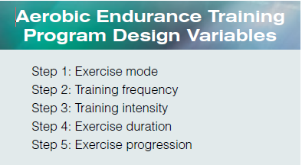
Designing An Aerobic Endurance Program

Slide 127
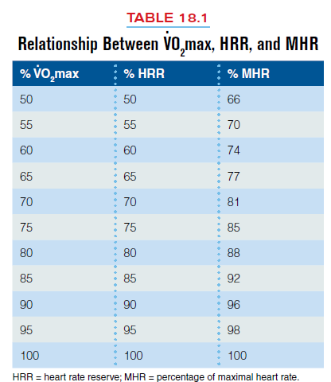
Designing An Aerobic Endurance Program

Slide 128
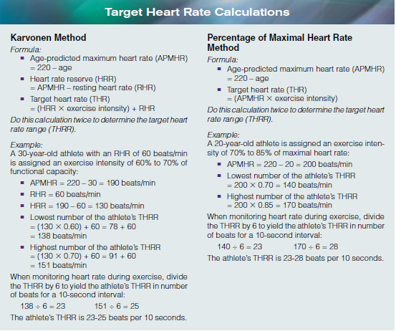

Slide 129
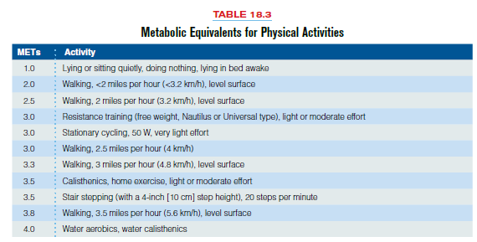

Slide 130
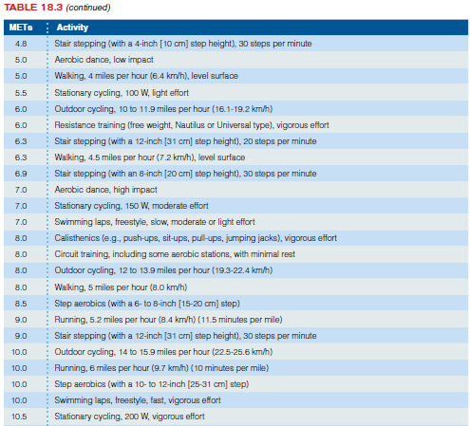

Slide 131
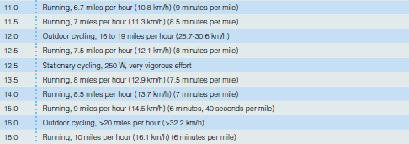

Slide 132
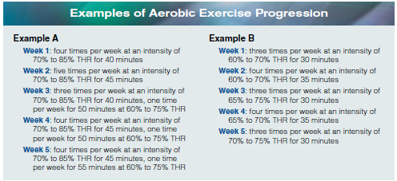

Slide 133
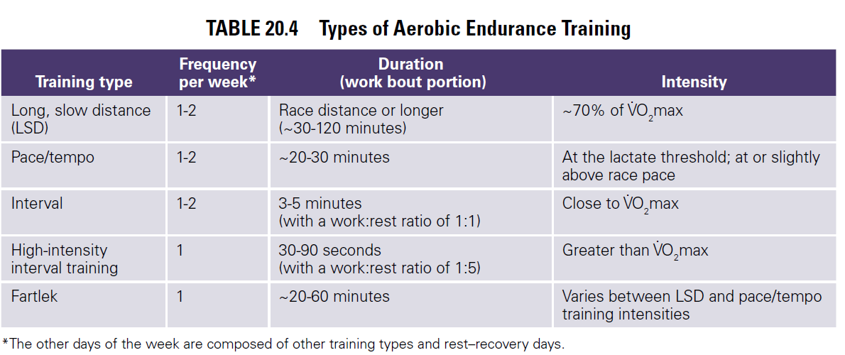
AEROBIC TRAINING

Slide 134
Long, slow Distance training
Traditionally, endurance coaches and athletes have used the term long, slow distance (LSD) to refer to training at intensities equivalent to approximately 70% of V.O2max (or about 80% of maximum heart rate).
The fitness professional and athlete should remember that the term slow refers to a pace that is slower than typical race pace.
In a LSD training session, the training distance should be greater than race distance, or the duration should be at least as long as 30 minutes to 2 hours.

Slide 135

Frequency: To help combat overtraining or overuse, the two LSD training days should be spread out evenly during the week to allow recovery between sessions.
Duration: Since the athlete’s race distance is a marathon (26.2 miles, 42 km), the duration or running distance of the LSD training sessions should approach those of the marathon (for a trained athlete), at least for one of the two LSD sessions.
Intensity: To complete the extended LSD sessions, the athlete should run at a lower intensity or training pace (minutes per mile or per km); high respiratory stress is not required.

Slide 136
Pace/Tempo Training
Pace/tempo training employs an intensity at or slightly higher than race competition intensity. The intensity corresponds to the lactate threshold; therefore, this type of training is also often called threshold training or aerobic–anaerobic interval training.
There are two ways to conduct pace/tempo training: steady and intermittent. Steady pace/tempo training is continuous training conducted at an intensity equal to the lactate threshold for durations of approximately 20 to 30 minutes.
The purpose of pace/tempo training is to stress the athlete at a specific intensity and improve energy production from both aerobic and anaerobic metabolism

Slide 137
Pace/Tempo Training
Intermittent pace/tempo training is also referred to as tempo intervals, cruise intervals, or threshold training.
During intermittent pace/tempo training, the intensity is the same as for a steady-threshold workout , but the training session consists of a series of shorter intervals with brief recovery periods between work intervals.

Slide 138
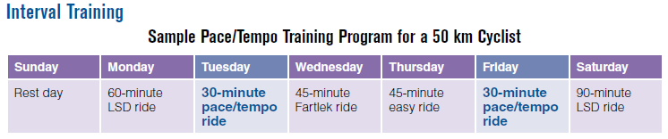
Frequency: Because the pace/tempo rides are stressful, the two training days should be spread out during the week to allow recovery between sessions.
Duration: For steady pace/tempo training, exercise duration is shorter than race distance or duration to allow for a higher training intensity.
Intensity: The athlete should cycle at a high intensity or training pace (minutes per mile or per km); high respiratory stress is required to simulate race pace.

Slide 139
Interval Training
Interval training involves exercise at intensities close to V.O2max. The work intervals should last between 3 and 5 minutes, although they can be as short as 30 seconds.
The rest intervals for 3- to 5-minute work interval should be equal to the work interval, thereby keeping the work:rest ratio (W:R) at 1:1.
Interval training permits the athlete to train at intensities close to V.O2max for a greater amount of time than would be possible in a single exercise session at a continuous high intensity.

Slide 140
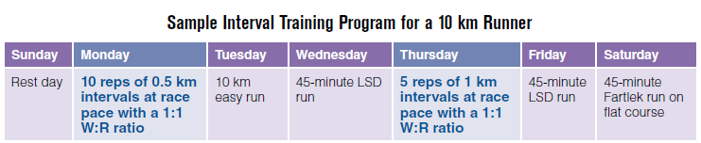
TYPES OF EROBIC TRAINING
Frequency: Because the interval runs are stressful, the two training days should be spread out during the week to allow recovery between sessions.
Duration: The total distance or duration of the training portion of the session (i.e., the sum of the interval work bouts) should approach the competition distances as the athlete becomes more highly trained.
Intensity: The athlete should run at an intensity (pace) close to V O2max when completing the work bout portions of the interval training sessions.

Slide 141
High-Intensity Interval Training
High-intensity interval training, or HIIT, is a form of training that uses repeated high-intensity exercise bouts interspersed with brief recovery periods.
An optimal stimulus it is necessary for athletes to spend several minutes within the HIIT session above 90% of the V.O2max. Both short (<45 seconds) and long (2- to 4-minute) HIIT intervals can be used to elicit different training responses

Slide 142
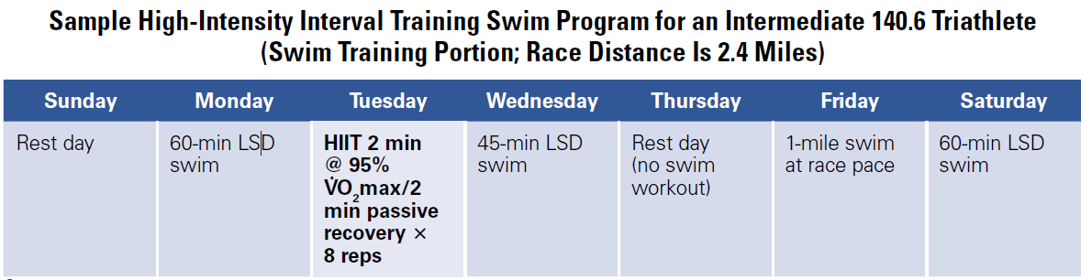
Frequency: Because the HIIT workouts are stressful, only one HITT training day should occur during the week.
Duration: Work bouts >2 to 3 minutes with ≤2-minute passive recovery between repetitions.
Repetitions: Six to 10 reps 2 minutes, 5 to 8 reps ≥ 3 minutes.
Intensity: The athlete should swim at an intensity (pace) at or above 90% V.O2max when completing the work bout portions of the HIIT sessions.

Slide 143
Fartlek training
Fartlek training (the word Fartlek originates from the Swedish term for speed play) is a combination of several of the previously mentioned types of training. Although Fartlek training is generally associated with running, it can also be used for cycling and swimming.
Sample Fartlek run involves easy running (~70% V.O2max) combined with either hill work or short, fast bursts of running (~85-90% V.O2max) for short time periods.
A Fartlek training workout challenges all systems of the body and may help reduce the boredom and monotony associated with daily training.

Slide 144
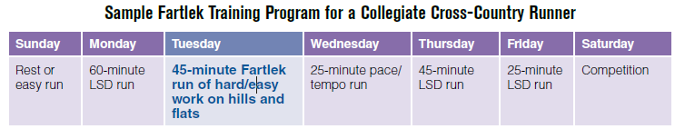

Slide 145
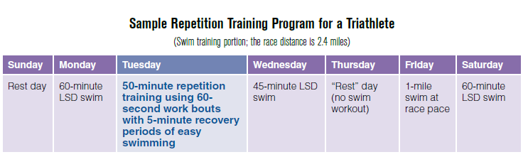
Frequency: Because the REPS workouts are stressful, only one training day should occur during the week.
Duration: The total distance or duration of the training portion of the session (i.e., the sum of the interval work bouts) should approach the competition distance as the athlete becomes more highly trained.
Intensity: The athlete should swim at an intensity (pace) higher than V.O2max when completing the work bout portions of the REPS training sessions.

Slide 146
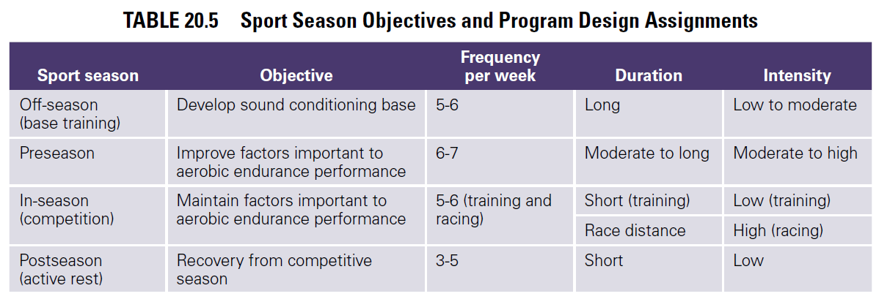
APPLICATION OF PROGRAM DESIGN TO TRAINING SEASONS

Slide 147
Special Issues Related To Aerobic Training
Cross-training is a mode of training that can be used to maintain general conditioning in athletes during periods of reduced training due to injury or during recovery from a training cycle
Cross-training may reduce the likelihood of overuse injuries because it distributes the physical stress of training to different muscle groups than those used during training

Slide 148
Special Issues Related To Aerobic Training
Detraining occurs when the athlete reduces the training duration or intensity or stops training altogether due to a break in the training program, injury, or illness. In the absence of an appropriate training stimulus, the athlete experiences a loss of the physiological adaptations brought about by training.

Slide 149
Special Issues Related To Aerobic Training
Tapering is an important component of the training program as aerobic endurance athletes prepare for major competition.
Tapering involves the systematic reduction of training duration and intensity, combined with an increased emphasis on technique work and nutritional intervention. The objective of tapering the training regimen is to attain peak performance at the time of competition

Slide 150
Special Issues Related To Aerobic Training
Resistance training is an important but often overlooked factor in improving performance in aerobic endurance athletes.
Overall, research on the effects of resistance training on performance in trained aerobic endurance athletes is limited; however, there are some data to suggest that benefits can be derived from performing resistance training during aerobic endurance training

Slide 151
Anaerobic Training
Resistance training
Plyometric training
Speed, agility, and speed-endurance development
There are three foundational principles that always apply: Specificity, Overload, and Progression. A lack of attention to any of these principles often produces less than desirable training outcomes and sometimes injury.

Slide 152
Specificity
Specificity: The term, first suggested by DeLorme in 1945 refers to the method whereby an athlete is trained in a specific manner to produce a specific adaptation or training outcome.
For example, to design a resistance training program that is specific to strengthening the chest muscles, the strength and conditioning professional must give an athlete an exercise like the bench press that recruits the pectoralis major.
(SAID), which stands for Specific Adaptation To Imposed Demands.

Slide 153
Specificity
The underlying principle is that the type of demand placed on the body dictates the type of adaptation that will occur.
For instance, athletes training for power in high-speed movements (e.g., baseball pitch, tennis serve) should attempt to activate or recruit the same motor units required by their sport at the highest velocity possible

Slide 154
Specificity
Specificity also relates to the athlete’s sport season. As an athlete progresses through the preseason, in-season, and postseason, all forms of training should gradually progress in an organized manner from generalized to sport specific

Slide 155
Overload
Overload refers to assigning a workout or training regime of greater intensity than the athlete is accustomed to.
Without the stimulus of overload, even an otherwise well-designed program greatly limits an athlete’s ability to make improvements.

Slide 156
Overload
Involves increasing the loads assigned in the exercises.
Other more subtle changes include increasing the number of sessions per week (or per day in some instances), adding exercises or sets, emphasizing complex over simple exercises, decreasing the length of the rest periods between sets and exercises, or any combination of these or other changes.

Slide 157
Progression
If a training program is to continue producing higher levels of performance, the intensity of the training must become progressively greater. Progression, when applied properly, promotes long-term training benefits.
One can progressively increase training intensity by raising the number of weekly training sessions, adding more drills or exercises to each session, changing the type or difficulty of the drills or exercises, or increasing the training stimulus.

Slide 158
Resistance Training Program Design Variables
1. Needs analysis
2. Exercise selection
3. Training frequency
4. Exercise order
5. Training load and repetitions
6. Volume
7. Rest periods

Slide 159
Resistance Training Program Design Variables
Needs Analysis: Evaluation of the requirements and characteristics of the sport and an Assessment of the athlete.
Body and limb movement patterns and muscular involvement (movement analysis)
Strength, power, hypertrophy, and muscular endurance priorities (physiological analysis)
Common sites for joint and muscle injury and causative factors (injury analysis)

Slide 160
Resistance Training Program Design Variables
Needs analysis
Evaluation of the requirements and characteristics of the sport
Other characteristics of a sport—such as cardiovascular endurance, speed, agility, and flexibility requirements—should also be evaluated

Slide 161
Resistance Training Program Design Variables
Needs Analysis:
2. Assessment of the Athlete:
The second task is to profile the athlete’s needs and goals by evaluating training (and injury) status, conducting a variety of tests (e.g., maximum strength testing), evaluating the results, and determining the primary goal of training.
The more individualized the assessment process, the more specific the resistance training program for each athlete can be.

Slide 162
Resistance Training Program Design Variables
Training Status-
-Type of training program,
- Length of recent regular participation in previous training program(s)
-Level of intensity involved in previous training program(s),
Degree of exercise technique experience (i.e., the knowledge and skill to perform resistance training exercises properly)

Slide 163
Resistance Training Program Design Variables
Physical testing and Evaluation:
Conducting assessments of the athlete’s strength, flexibility, power, speed, muscular endurance, body composition, cardiovascular endurance, and so on.

Slide 164
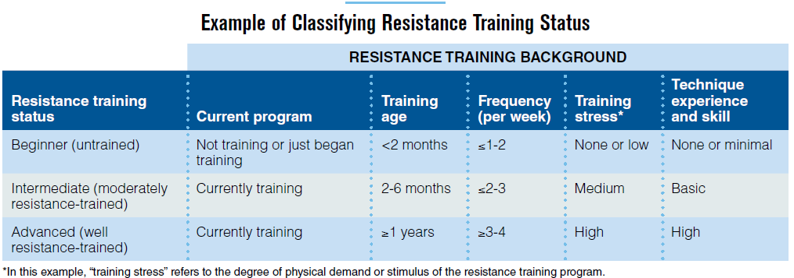
Resistance Training

Slide 165
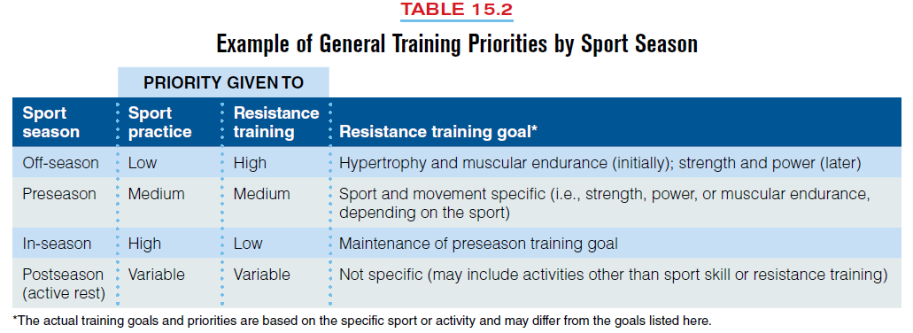

Slide 166
2. Exercise Selection
Exercise types -Most involve primary muscle groups or body areas and fall into categories based on their relative importance to the athlete’s sport
Core and Assistance Exercises
Exercises can be classified as either core or assistance based on the size of the muscle areas involved and their level of contribution to a particularsport movement.

Slide 167
2. Exercise Selection
Core exercises recruit one or more large muscle areas (i.e., chest, shoulder, back, hip, or thigh), involve two or more primary joints (multi joint exercises), and receive priority when one is selecting exercises because of their direct application to the sport.

Slide 168
2. Exercise Selection
Assistance exercises usually recruit smaller muscle areas (i.e., upper arm, abdominals, calf, neck, forearm, lower back, or anterior lower leg), involve only one primary joint (single-joint exercises), and are considered less important to improving sport performance.
Generally, all the joints at the shoulder—the glenohumeral and shoulder girdle articulations—are considered one primary joint when resistance training exercises are categorized as core or assistance.

Slide 169
2. Exercise Selection
A common application of assistance exercises is for injury prevention and rehabilitation, as these exercises often isolate a specific muscle or muscle group.

Slide 170
2. Exercise Selection
Structural and Power Exercises-A core exercise that emphasizes loading the spine directly (e.g., back squat) or indirectly (e.g., power clean) can be further described as a structural exercise.
More specifically, a structural exercise involves muscular stabilization of posture during performance of the lifting movement (e.g., maintaining a rigid torso and a flat back during the back squat).

Slide 171
2. Exercise Selection
A structural exercise that is performed very quickly or explosively is considered a power exercise Typically, power exercises are assigned to athletes when they are appropriate for the athlete’s sport-specific training priorities
Movement Analysis of the Sport-This is the specificity concept, also called the specific adaptation to imposed demands (SAID) principle.

Slide 172
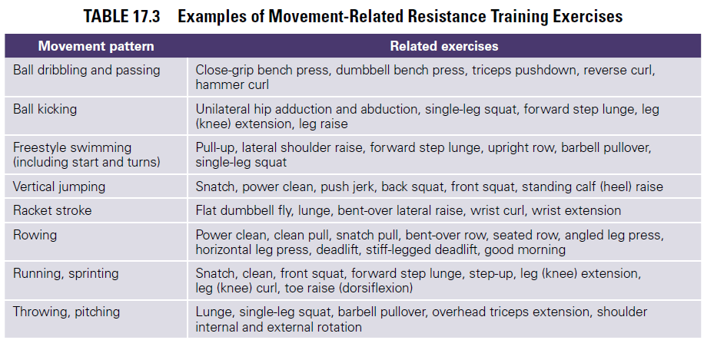

Slide 173
Muscle Balance Exercises selected for the specific demands of the sport should maintain a balance of muscular strength across joints and between opposing muscle groups (e.g., biceps brachii and triceps brachii).
Avoid designing a resistance training program that increases the risk of injury due to a disparity between the strength of the agonist, the muscle or muscle group actively causing the movement (e.g.,the quadriceps in the leg [knee] extension exercise), and the antagonist, the sometimes passive (i.e., not concentrically involved) muscle or muscle group located on the opposite side of the limb (e.g., the hamstrings in the leg [knee] extension exercise).

Slide 174
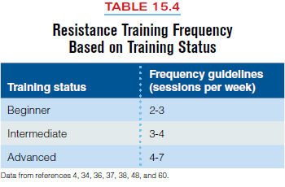
3. Training Frequency
common time period is one week.

Slide 175
Step 4: Exercise Order
Usually exercises are arranged so that an athlete’s maximal force capabilities are available (from a sufficient rest or recovery period) to complete a set with proper exercise technique

Slide 176
Step 5: Training Load and Repetitions
Load is most simply referred to as the amount of weight assigned to an exercise set and is often characterized as the most critical aspect of a resistance training program.
Relationship Between Load and Repetitions The number of times an exercise can be performed (repetitions) is inversely related to the load lifted; the heavier the load, the lower the number of repetitions that can be performed. Therefore, focusing on one training goal automatically implies the use of a certain load and repetition regime (e.g., training for muscular strength involves lifting heavy loads for few repetitions).

Slide 177
1RM and Multiple-RM Testing Options
1.Actual 1RM (directly tested),
2.Estimated 1RM from a multiple-RM test (e.g., a 10RM), or
3.Multiple RM based on the number of repetitions planned for that exercise (the “goal” repetitions; e.g., five repetitions per set).

Slide 178
Step 6: Volume
Volume relates to the total amount of weight lifted in a training session and a set is a group of repetitions sequentially performed before the athlete stops to rest Repetition-volume is the total number of repetitions performed during a workout session.

Slide 179
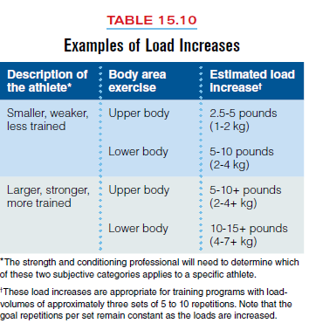

Slide 180
Plyometric Training
Plyometric exercise refers to those activities that enable a muscle to reach maximal force in the shortest possible time. “Plyometric” is a combination of Greek words that literally means to increase measurement ( plio = more; metric = measure.

Slide 181
Plyometric Training
Practically defined, plyometric exercise is a quick, powerful movement using a prestretch, or countermovement, that involves the stretch-shorteningcycle (SSC).

Slide 182
Plyometric Training
The purpose of plyometric exercise is to increase the power of subsequent movements by using both the natural elastic components of muscle and tendon and the stretch reflex. To effectively use plyometrics as part of a training program, it is important to understand: (1) the mechanics and physiology of plyometric exercise, (2) principles of plyometric program design, and (3) methods of safely and effectively performing specific plyometric exercises.

Slide 183
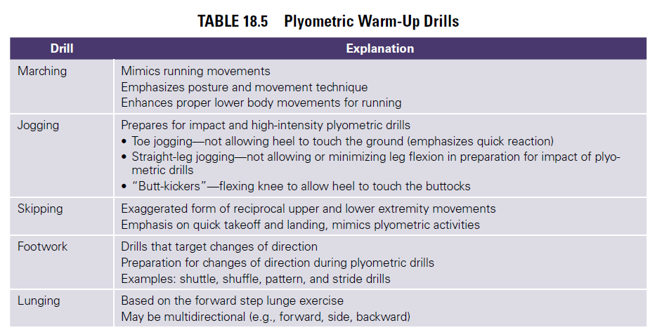

Slide 184
